Slide 1
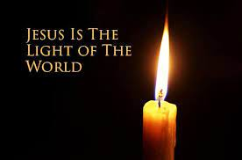
This Little Light of Mine
https://www.google.com/search?q=this+little+light+of+mine&source=lmns&bih=720&biw=1046&rlz=1C1GCEU_en-GBGB1040GB1040&hl=en-US&sa=X&ved=2ahUKEwilnfWwoMn8AhXFsCcCHSGVC6AQ_AUoAHoECAEQAA#fpstate=ive&vld=cid:387fe6ff,vid:cKkbIZtqhyQ

Slide 2
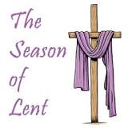
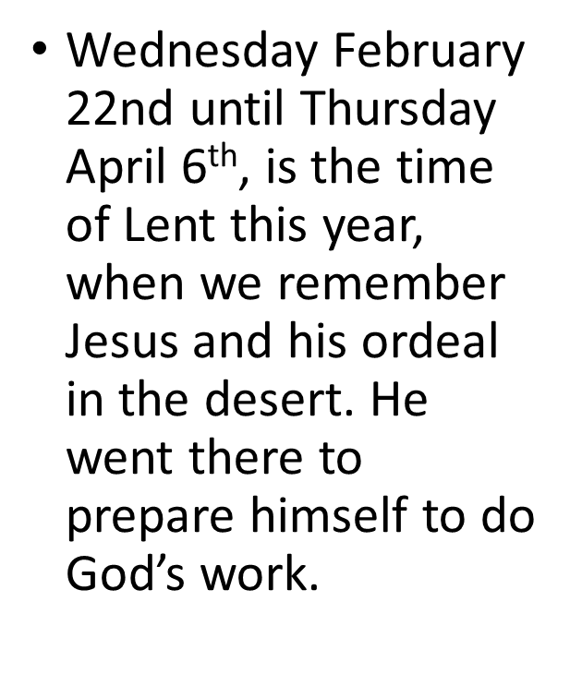
What is resilience?

Slide 3
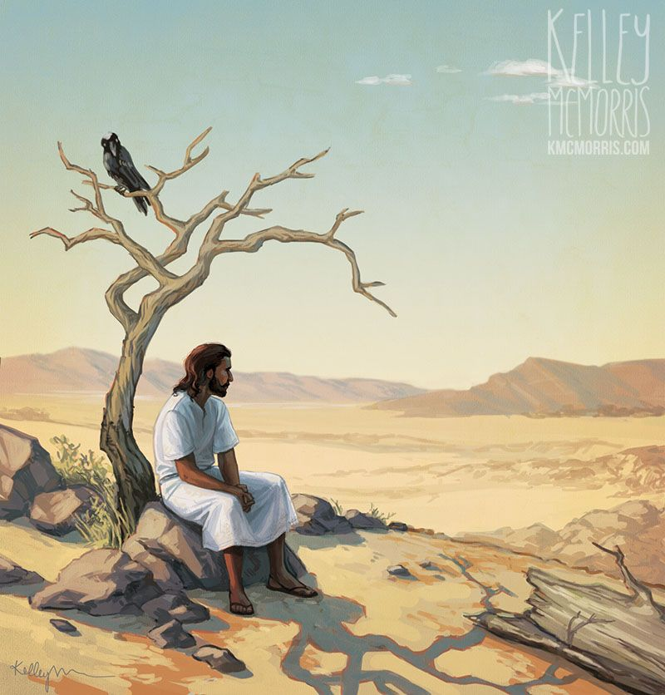
Jesus showed great resilience when he fasted in the desert for 40 days and nights.
Matthew 4:1-11
At that time Jesus was led by the Spirit into the desert to be tempted by the devil. He fasted for forty days and forty nights and afterwards was hungry. The tempter approached and said to him, “If you are the Son of God, command that these stones become loaves of bread.

Slide 4

Looking out at the world

Slide 5
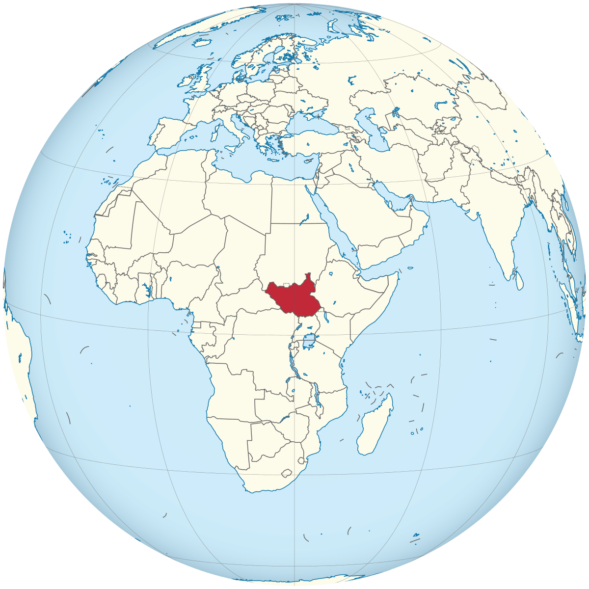

In modern times many people have to show great bravery and resilience in times of trouble and hardship.
Today we are going to Sudan , to meet someone who is doing their best to encourage others to be resilient.

Slide 6
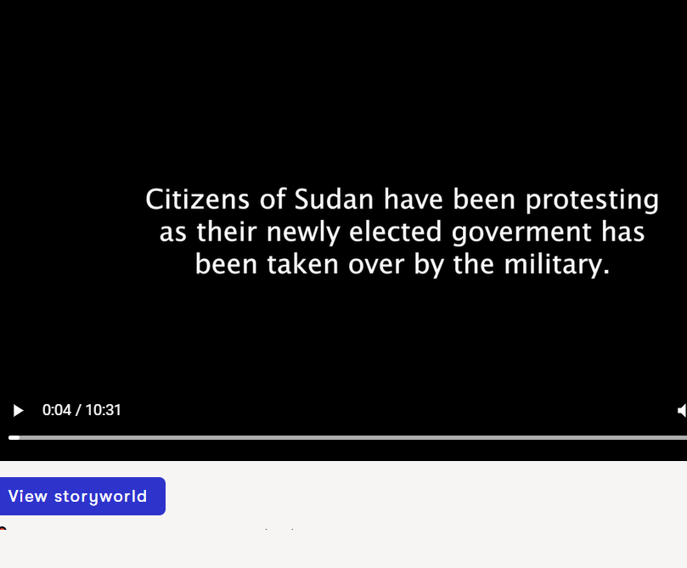
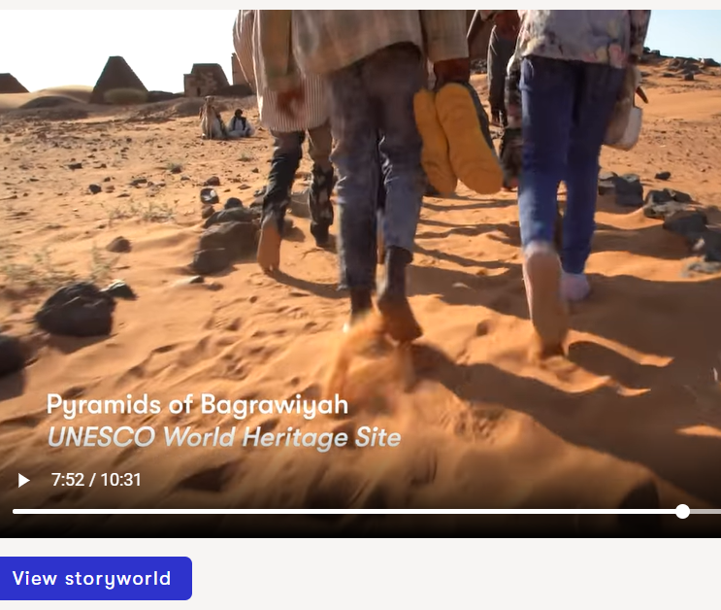
https://teacher.lyfta.com/resource/preview/2109
0-4.31 mins
7.31—10 mins

Slide 7
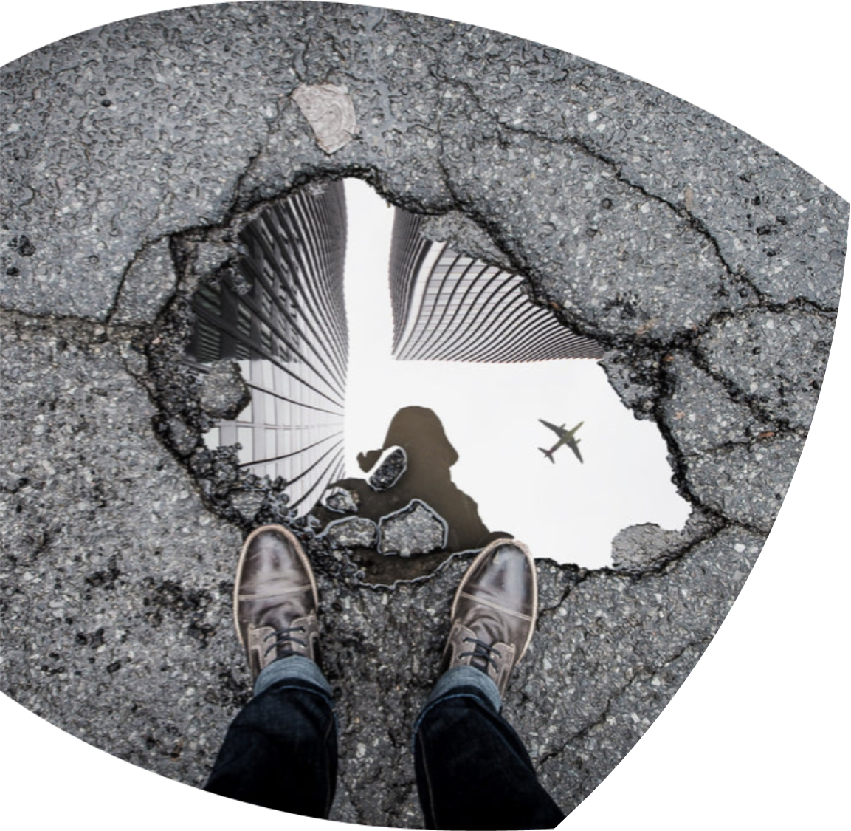
Reflecting on what we have learnt….
What can WE do???

Slide 8
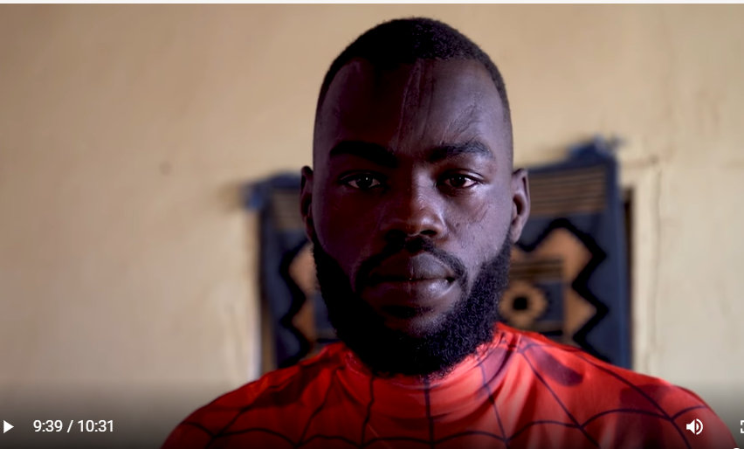
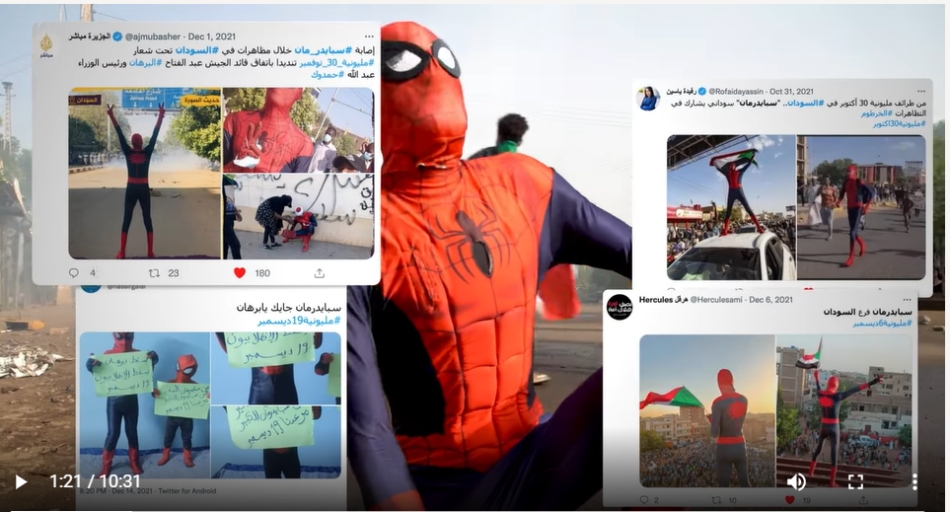
Why does Sudan need Spiderman?
Why is he masked?
Why did he unmask himself?
What do you think?.....

Slide 9
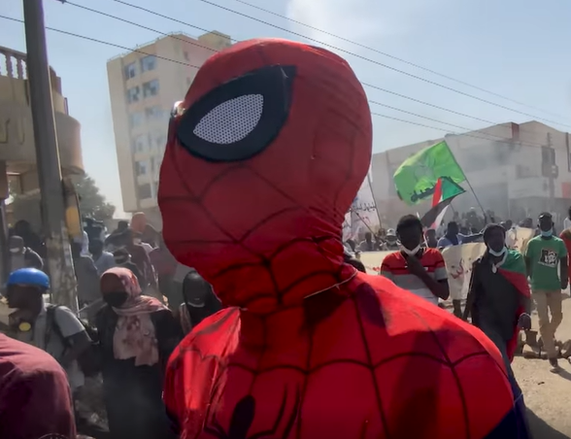
Dear Lord
Help us to be resilient.
Help us to stick to what we believe is right and to do what we find difficult..
Help us to remember how others have shown us how.
We ask this in Jesus name
Amen

Slide 10

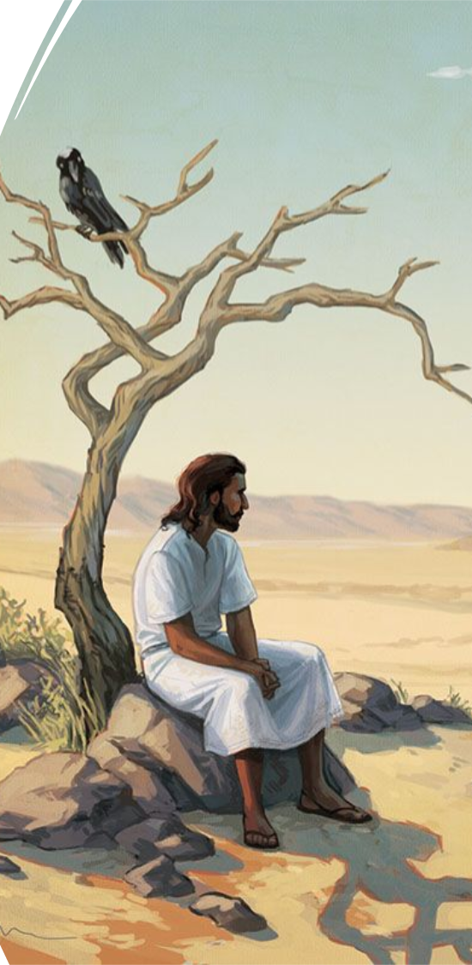

Can you be resilient in your daily life?
Will you be able to do what you believe is right even when it is hard?

