Slide 1
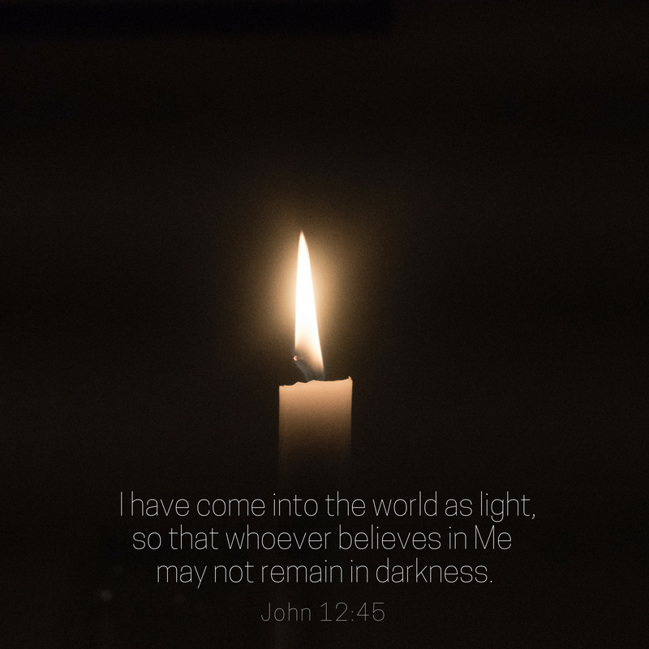
We light the candle

Slide 2
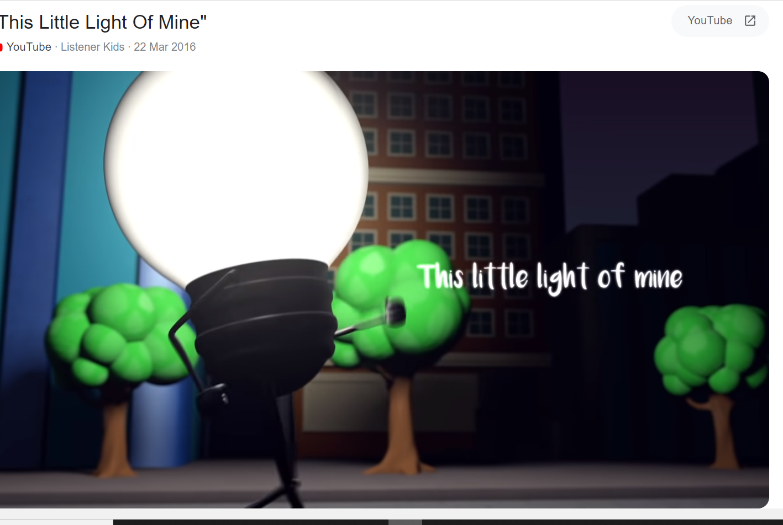
https://www.google.com/search?q=this+little+light+of+mine&rlz=1C1GCEU_en-GBGB1024GB1024&oq=this+little+light+of+mine&aqs=chrome.0.0i271j46i512j0i512l6j46i512j0i512.6595j0j15&sourceid=chrome&ie=UTF-8#fpstate=ive&vld=cid:387fe6ff,vid:cKkbIZtqhyQ

Slide 3

Resilience
Is the Christian value that we will explore this half term.
Resilience, Respect, Kindness, Compassion, Honesty, friendship

Slide 4

Looking out at the world

Slide 5
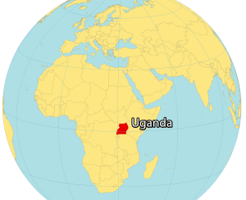
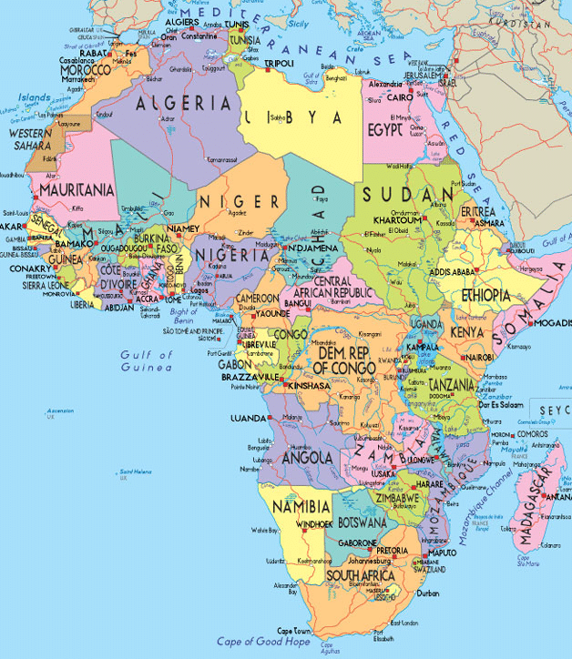
Today we are visiting Uganda

Slide 6
Challenging stereotypes
What is a stereotype??- discuss
How can we “challenge” a stereotype?

Slide 7
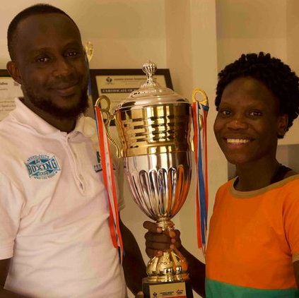
Fighting for what you believe in
This is a story of determination and fighting against the odds. When Catherine won her first international fight at the age of 20 she qualified for the Olympic Games in Tokyo. This was a huge achievement and she began to receive worldwide coverage after qualifying as Uganda’s first female boxer.
“And when you have a dream
make sure that you do everything
that you are supposed to do
so that you really stick to that dream.”
— CATHERINE IN BOXING CLEVER

Slide 8
Challenging stereotypes
Catherine’s interest in boxing began at school. Her father was dismissive of her interest in what he described as a “male sport”. He was worried that nobody would marry his daughter. Although Catherine was angry at her father and thought of giving up, she kept on pursuing her dream with encouragement from her manager who “kept on giving her hope”
https://teacher.lyfta.com/search/storyworlds/preview/2094
Story world- roll with the punches

Slide 9

Reflecting on what we have learnt

Slide 10
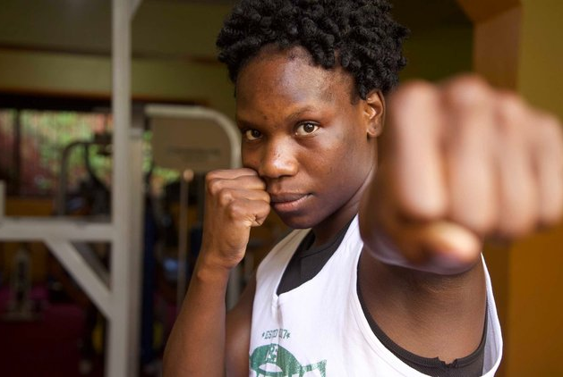
“A female boxer is unique so I give it all that I can.”— CATHERINE IN BOXING CLEVER

Slide 11
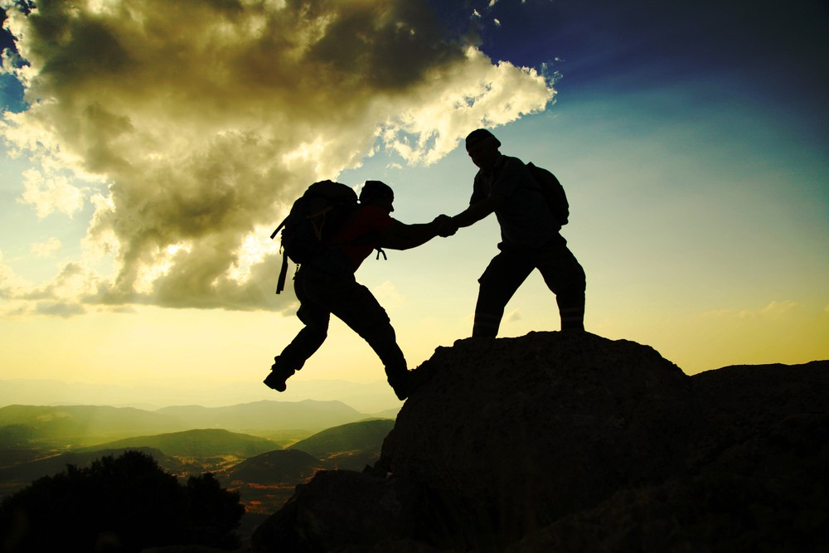
Prayer
Dear Lord
Help us to challenge ourselves and to challenge stereotypes.
Help us to achieve our dreams and to be resilient as we reach for the stars.
Amen

Slide 12

Acting on what we have learnt…

Slide 13
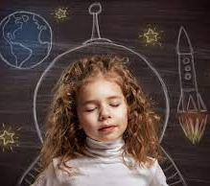
What challenges are you going to give yourself?
What dreams would you like to achieve?
Speak to your talk partners

