Slide 1
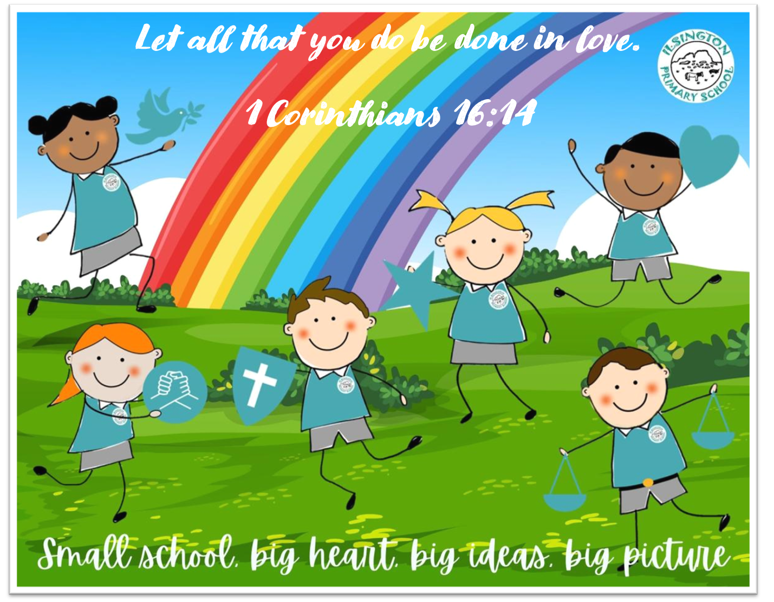
You Are Wonderfully Made
💛 Respecting Ourselves

Slide 2
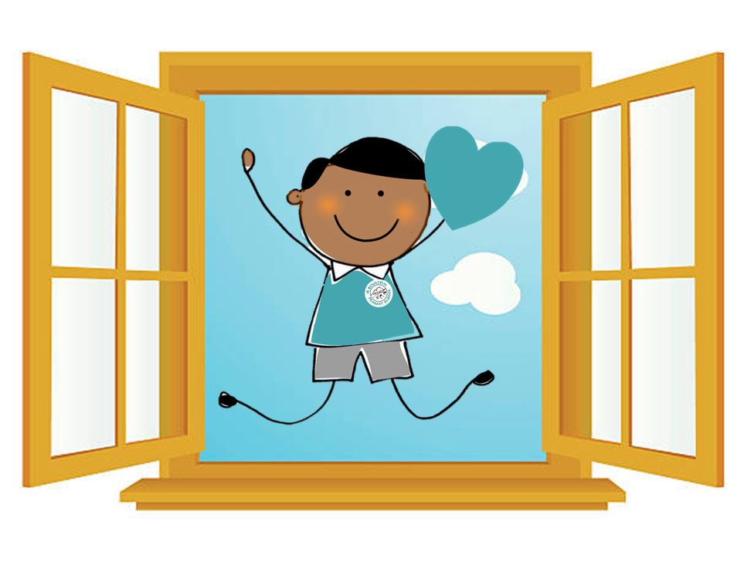
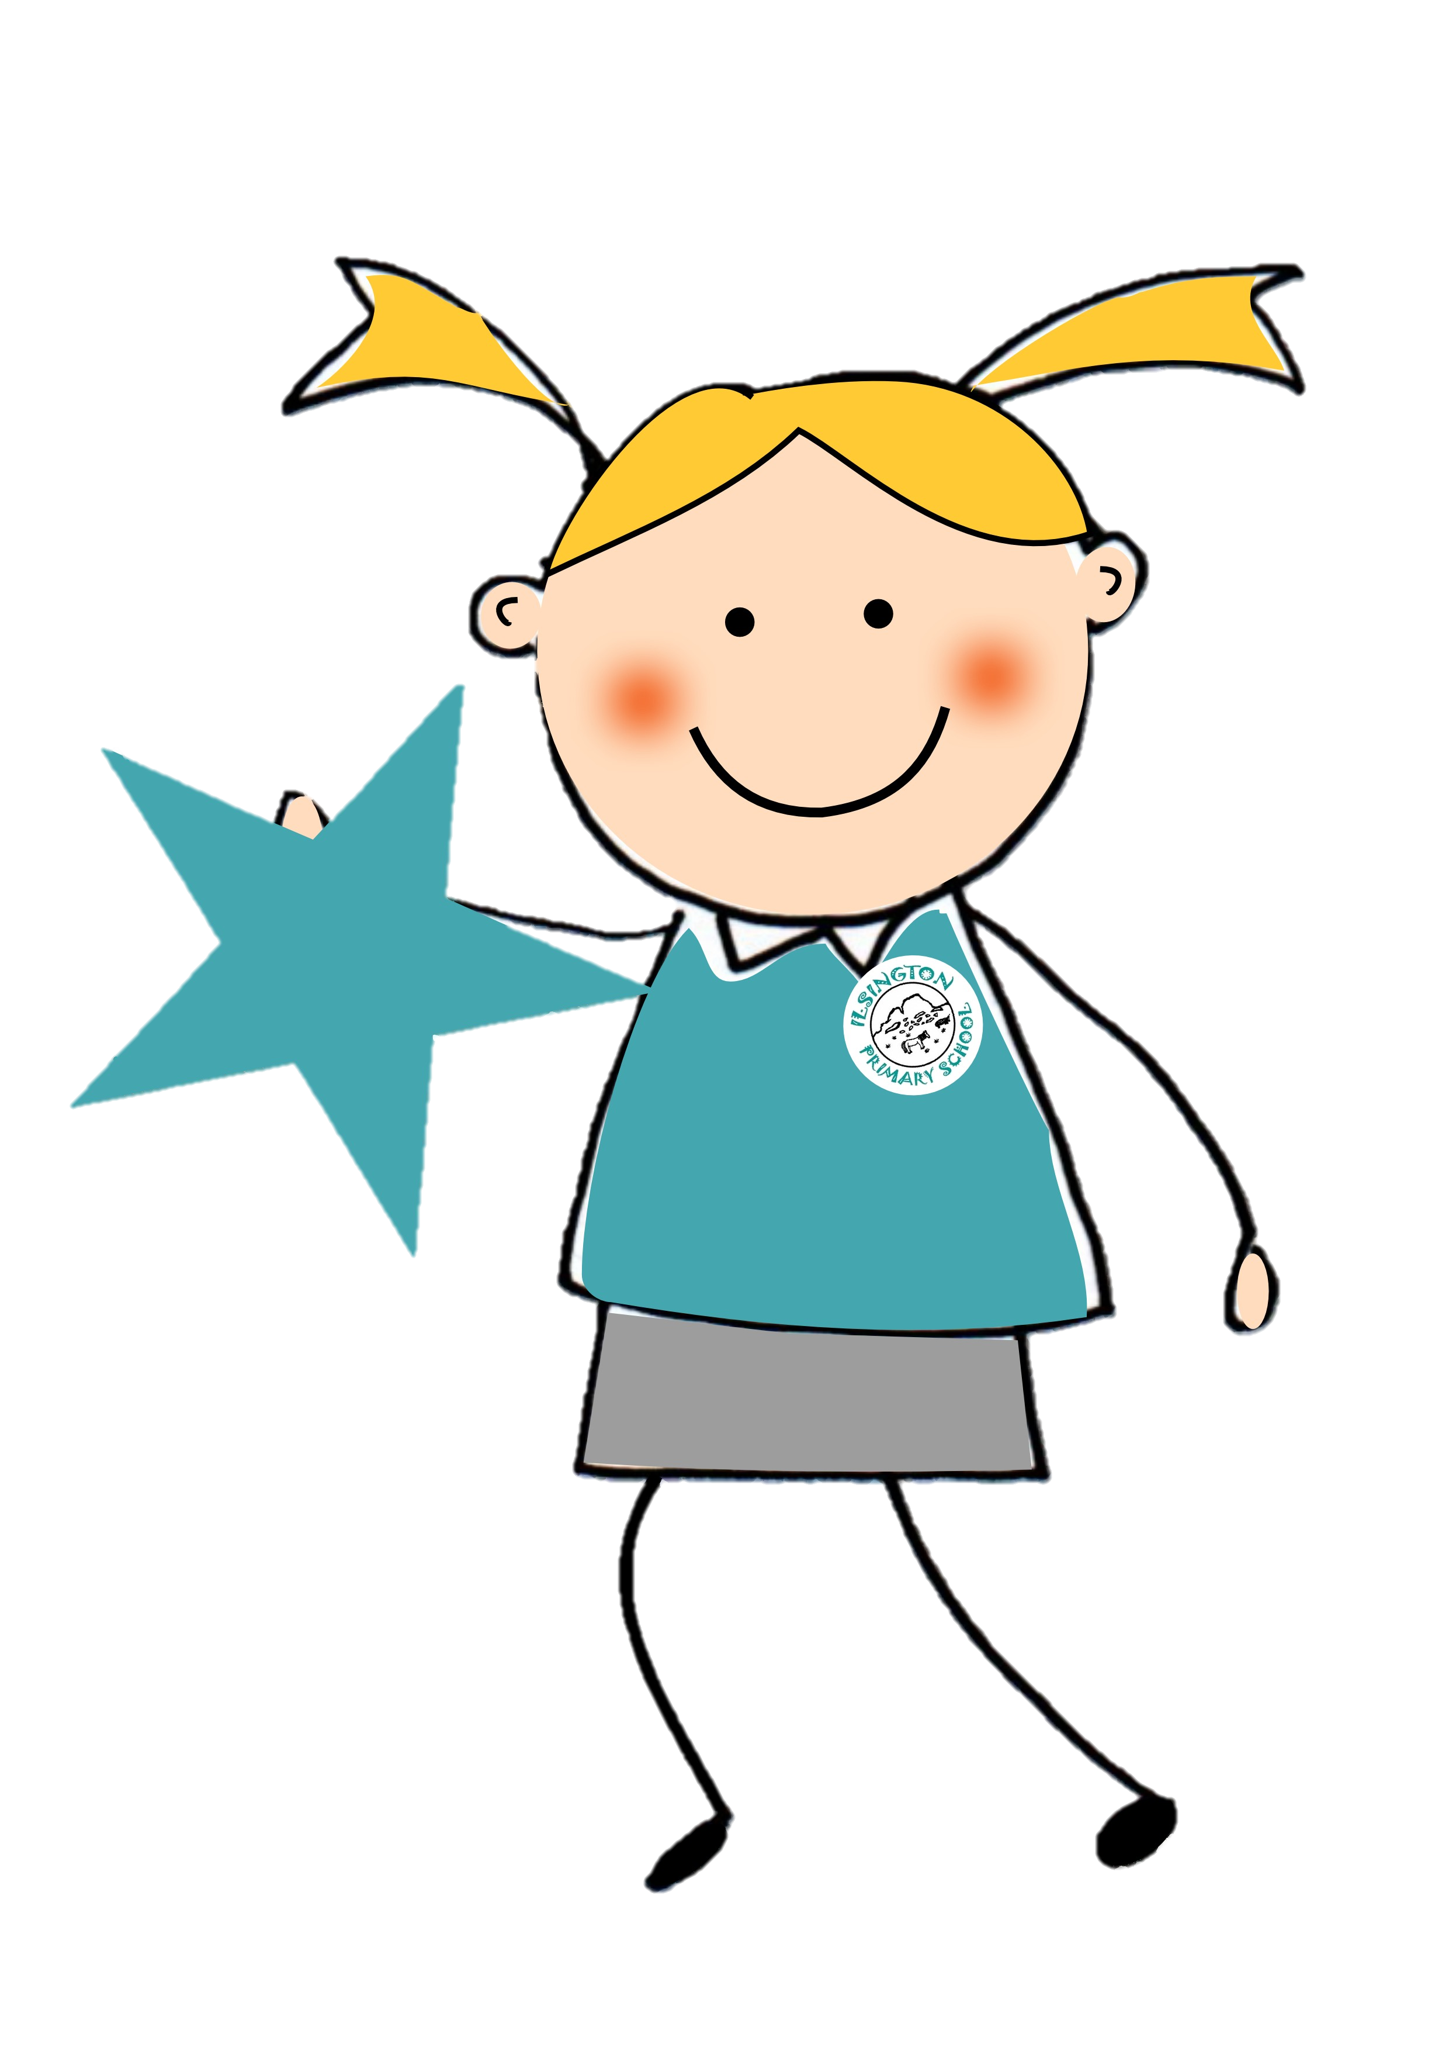
You Are Wonderfully Made
💛 Respecting Ourselves
Psalm 139
What does that mean?

Slide 3
Welcome & Introduction
Today we’re going to think about something very special – that every single one of us is unique, valuable, and wonderfully made.
What does it mean to be unique?

Slide 4
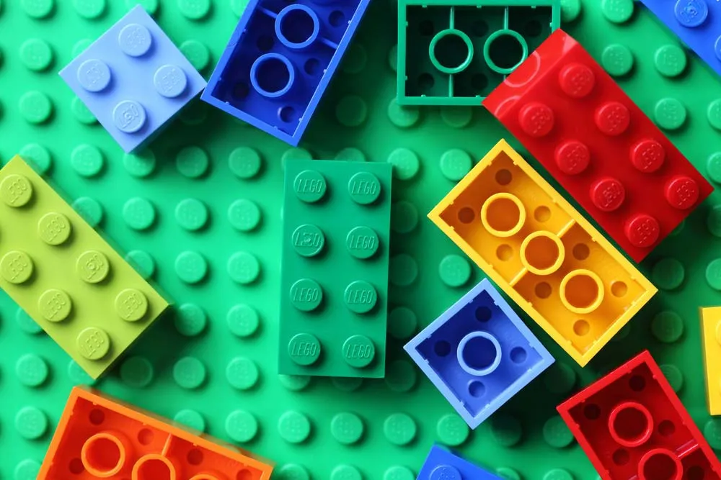
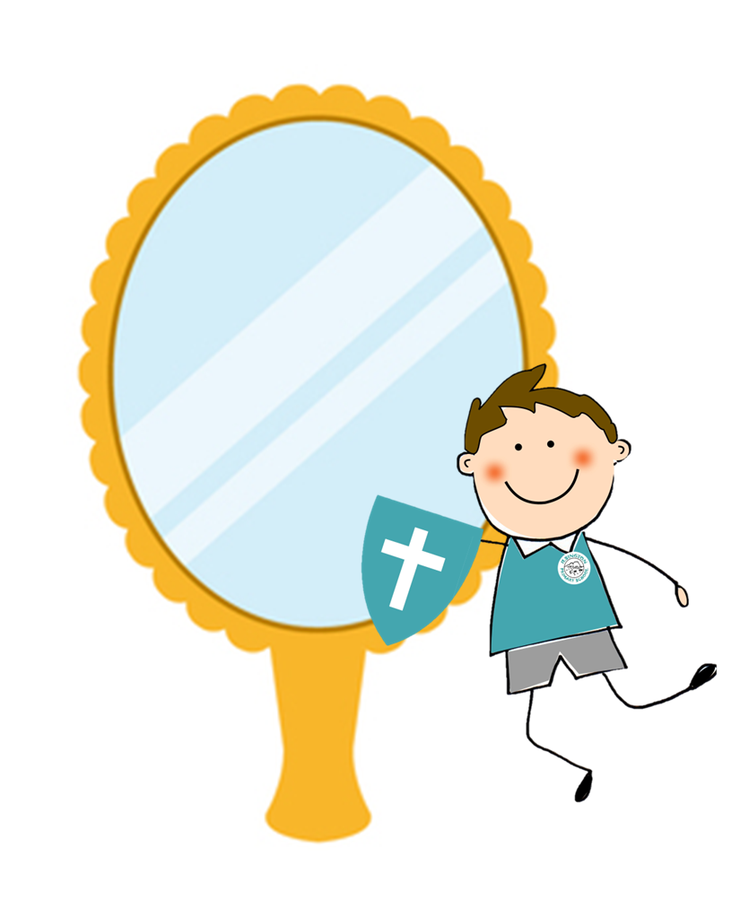
What Do You See?
Look at these Lego….
Are they all the same?
No! They’re different, but together they make something beautiful – just like us!

Slide 5
Bible Link – Psalm 139
“I praise you because I am fearfully and wonderfully made.” (Psalm 139:14)
God made each one of us carefully, with love. We are all special.
What makes you special?

Slide 6
Amira’s Special Gift
Sometimes we think we’re not good at something. But everyone has a gift. Maybe not running fast, but being kind, drawing, or helping others.
The Story: Amira’s Special Gift
Amira loved sports day at school. She always tried her best in the races, but she never came first. In fact, she often came last.
One year, she felt sad and thought, “I’m not good at anything.”
But then, during art week, something amazing happened. Amira painted a huge, colourful picture of a butterfly. Everyone loved it! Her teacher said, “Wow, Amira, you have a real gift for art. Your painting makes people smile.”
That day, Amira realised something very important: she didn’t have to be the fastest runner to be special. She had her own wonderful gift, and it was just as important.
Message:
We all have different gifts – some can run fast, some draw beautifully, some are kind friends, some tell great jokes. God made each of us unique, and that makes the world brighter. 🌟

Slide 7
Think About…
• What makes you special?
• Do we all have to be good at the same things?
Remember: Being wonderfully made means you are valuable just as you are.

Slide 8

Prayer / Reflection
Prayer:
Thank you, God, for making each of us unique and special. Help us remember we are wonderfully made, and treat others the same.
Amen
Or:
Take a moment to think of one thing that makes you unique and one thing that makes someone else special.

Slide 9
Closing Thought
Remember: You don’t need to be like anyone else. You are wonderfully made, and the world is better because you are in it.

